Slide 1
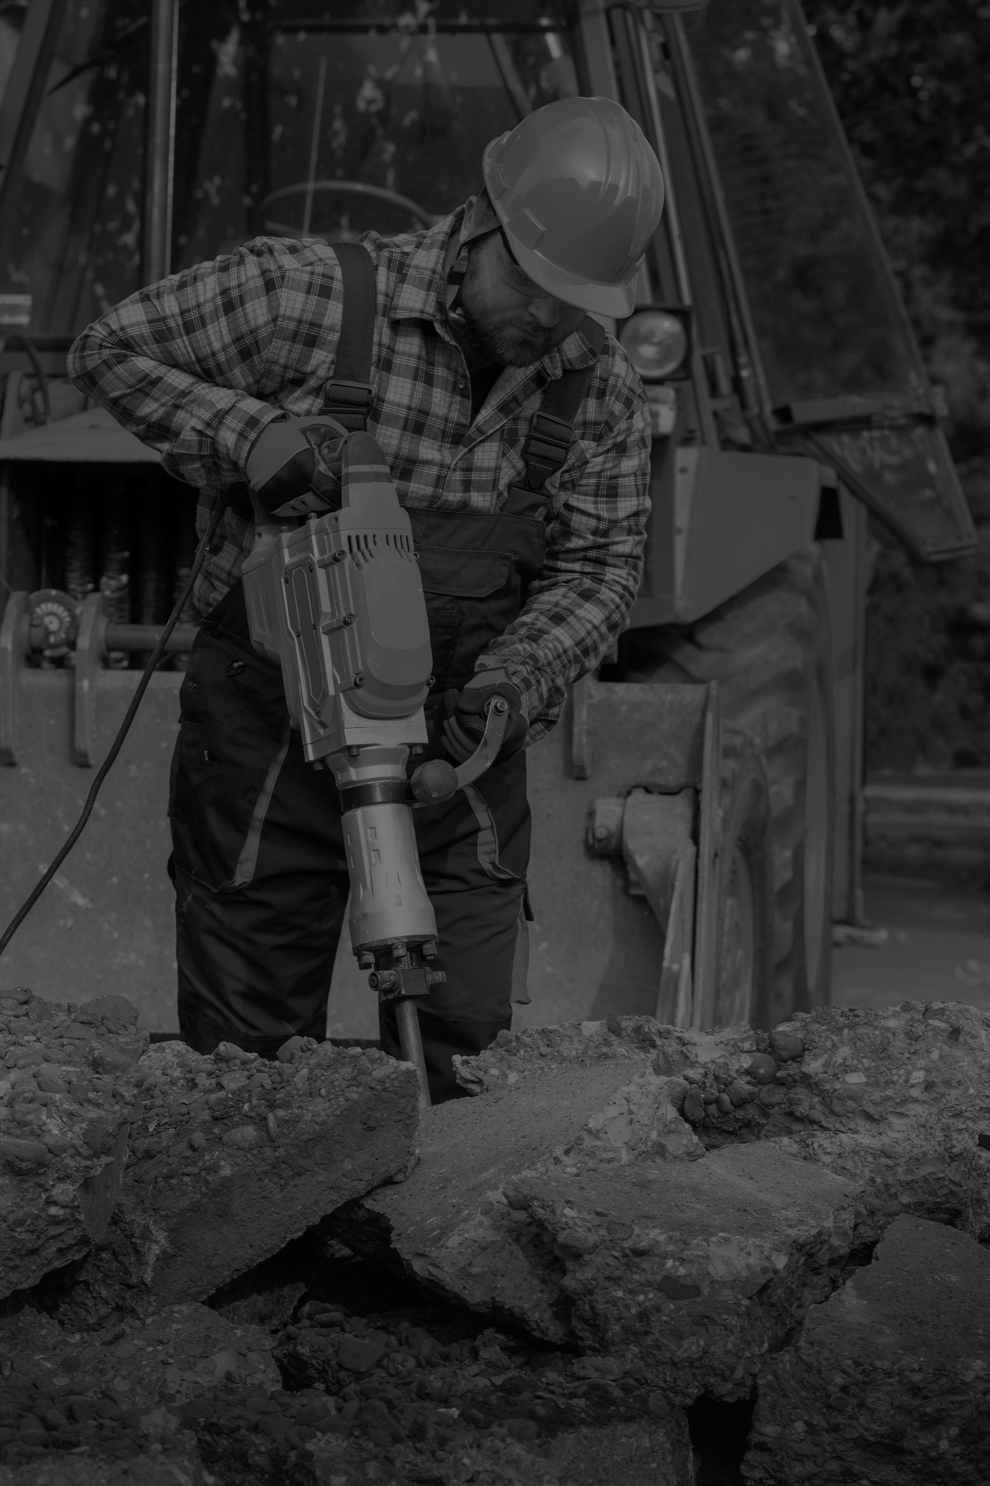




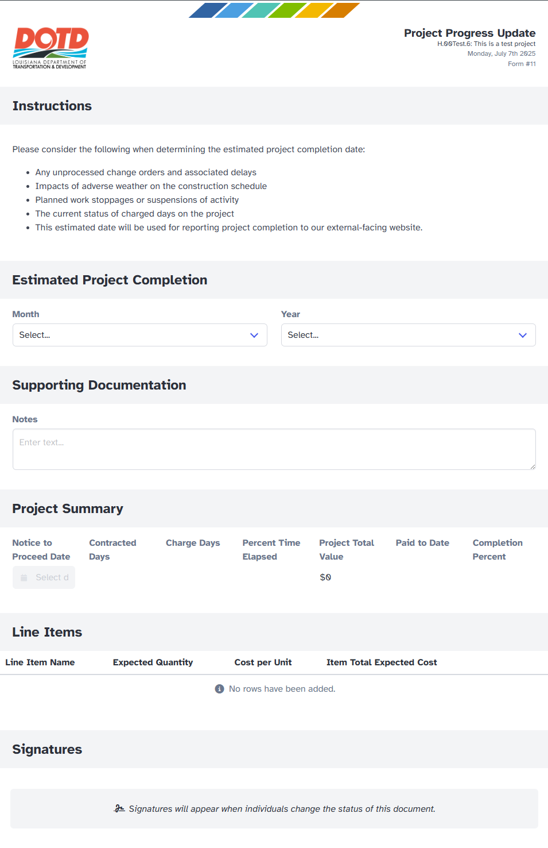
ECONSTRUCTION
NEWS
JULY 2025
Key Message: Building a Better Viewer—One Update at a Time
Last month, we introduced the Project Progress Update Form as a required tool for all active LADOTD construction projects. While the form itself is quick and easy to complete, it plays a key role in our long-term goal of improving how we share project progress with the public.
Although the form isn’t yet connected to the LADOTD Project Viewer, we’re laying the groundwork now. Once fully implemented, the data you enter—especially projected completion dates—will help provide more accurate, transparent updates for the traveling public and other stakeholders. Full integration is coming soon.
Thank you to those who’ve already started using the form. Your efforts are helping us build a stronger, more reliable system. If you have feedback to make the form more user-friendly or need help getting started, don’t hesitate to reach out to the HeadLight team (HeadLight Support Link Below).
As always, thank you for everything you do to keep our projects—and our communication—moving forward.
LADOTD e-Construction Team
JOIN
ECONSTRUCTION WEBINAR
7/08/25
10:00AM
JOIN
CONSTRUCTION ROUNDUP WEBINAR
7/16/25
10:00AM
JOIN
FIELDBOOK 101 TRAINING
7/22/25
10:00AM
HeadLight Support
e-Con
Support
HeadLight Academy
Feedback Survey
HaulHub University
Construction YouTube

Slide 2
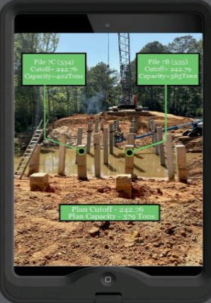


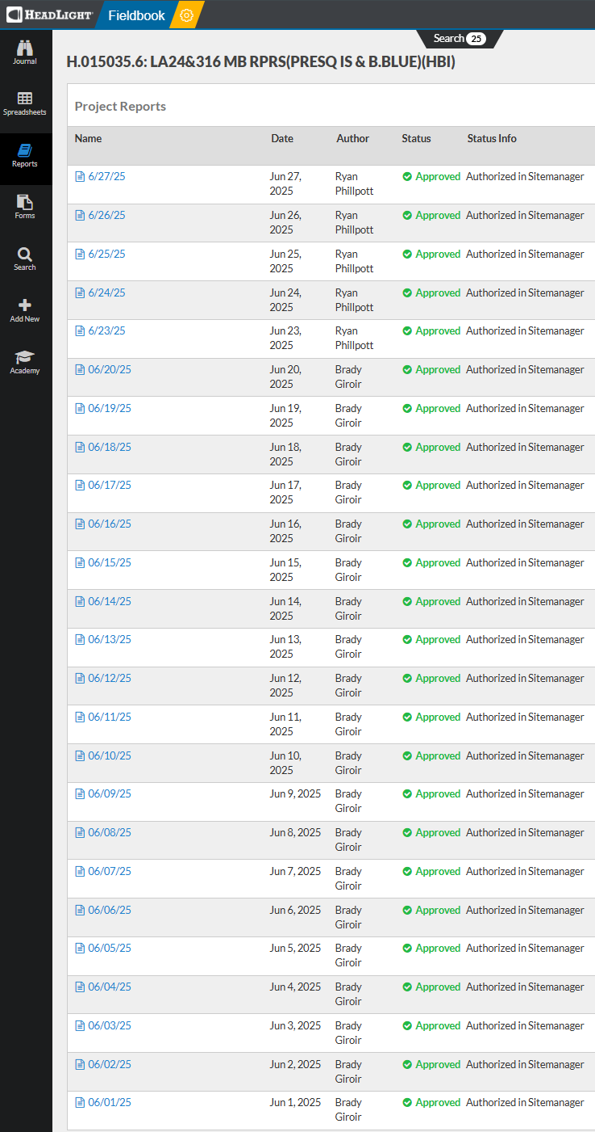
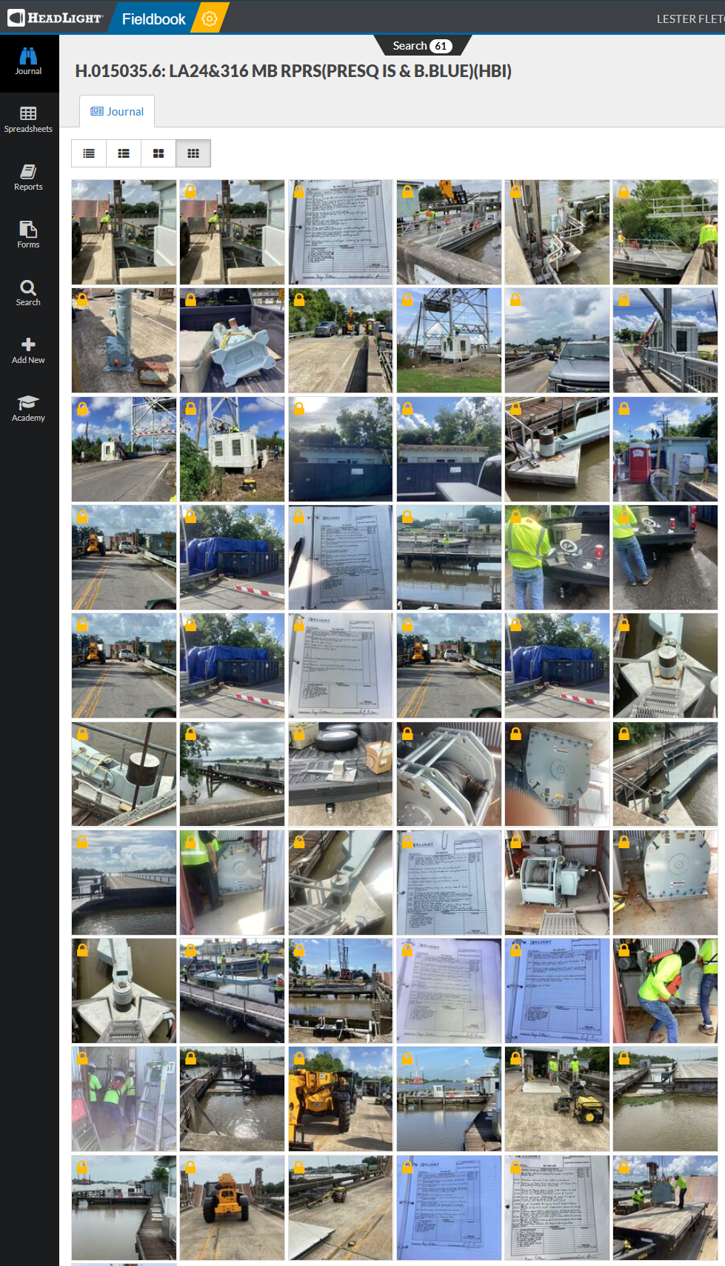
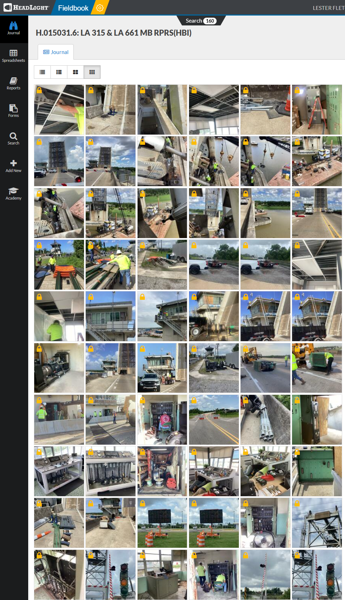
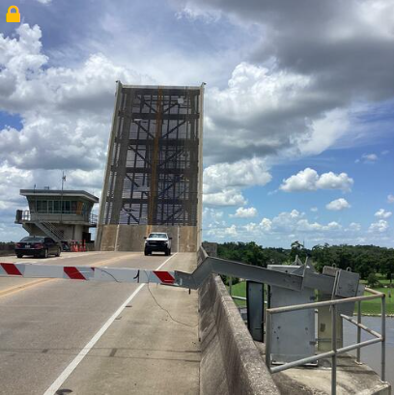
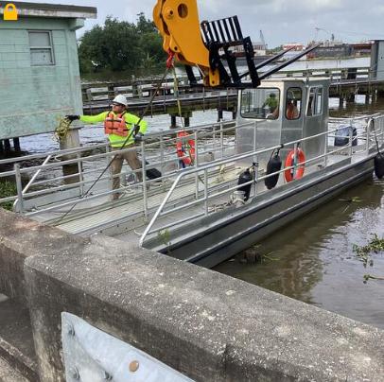
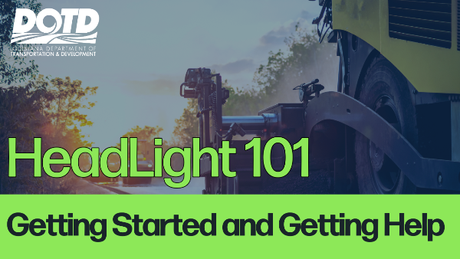
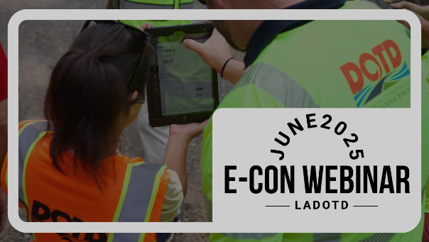
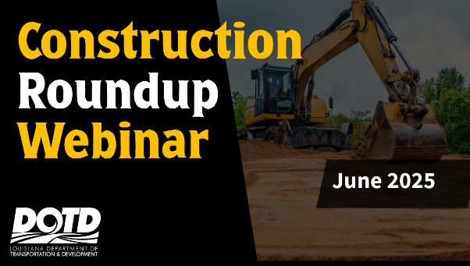
HeadLight Hero
Nomination
HeadLight Hero of the Month:
District 02-Unit 292
Brady Giror
Ryan Phillpott
Matthew Burgess (PE)
Know someone who’s excelling with HeadLight? Click the iPad trophy to nominate them for their outstanding documentation efforts. Let’s celebrate their hard work and inspire others!
This month’s HeadLight Hero spotlight shines on Unit 292 in District 02 for their outstanding documentation efforts on two movable bridge repair projects:
H.015031.6: LA 315 & LA 661 MB RPRS
H.015035.6: LA 24 & LA 316 MB RPRS (Presque Isle & Bayou Blue)
Brady Giror and Ryan Phillpott did an exceptional job capturing detailed photo documentation of the work as it progressed, using HeadLight to provide a clear and complete record of each phase of construction. Their observations helped tell the story of the job in real time.
Project Engineer Matthew Burgess ensured a smooth workflow by promptly reviewing and approving reports, keeping communication clear and documentation up to date. The team’s collaborative approach and efficient use of HeadLight set a strong example for documentation best practices.
Great work, Unit 292—your efforts contribute to better projects and stronger records across Louisiana!
Training
HeadLight 101 – Getting Started
This session kicks off the monthly HeadLight training series, focused on helping LADOTD users document projects effectively and meet contract requirements. It covers how to access HeadLight across devices, key app functions, available support resources, and what’s coming next in future trainings.
June e-Construction Webinar - This session focused on key operational issues in HeadLight, including correct use of location sequence numbers for syncing with SiteManager, common system bugs, and app access across devices. Updates were shared on the iPad refresh process, VPN changes, and upcoming features like contract administration and e-Ticketing. The team also highlighted support resources, training plans for new users, and ongoing pilot projects aimed at modernizing construction workflows.
June Construction Roundup Webinar
This session covered statewide updates and district-requested topics, including adverse weather day calculations, prompt payment procedures, new project progress forms in HeadLight, and asphalt patching standards. Attendees also heard updates on DOTD reorganization, SmartPM scheduling software, and the launch of HeadLight’s contract administration pilot. Additional topics included traffic control documentation, e-Ticketing guidance, and plans for upcoming training and in-person roundups.

