Slide 1

Spreadsheet Applications for Construction Cost Estimating
By Jonathon Courtney
Jonathon.Courtney@la.gov
(225) 379-1078

Slide 2
Key Cost Driving Relationships
(The Usual Suspects)
Competition
  Only look at projects with at least 3 or more bidders
  Only look at the top 2 bidders
Size of Project
Quantity
Type of Project
Location
  DOTD District
  Parish

Slide 3
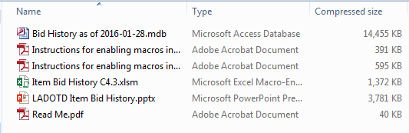
Item Bid History Spreadsheet Application
Bid History
Application

Slide 4
Demonstration

Slide 5
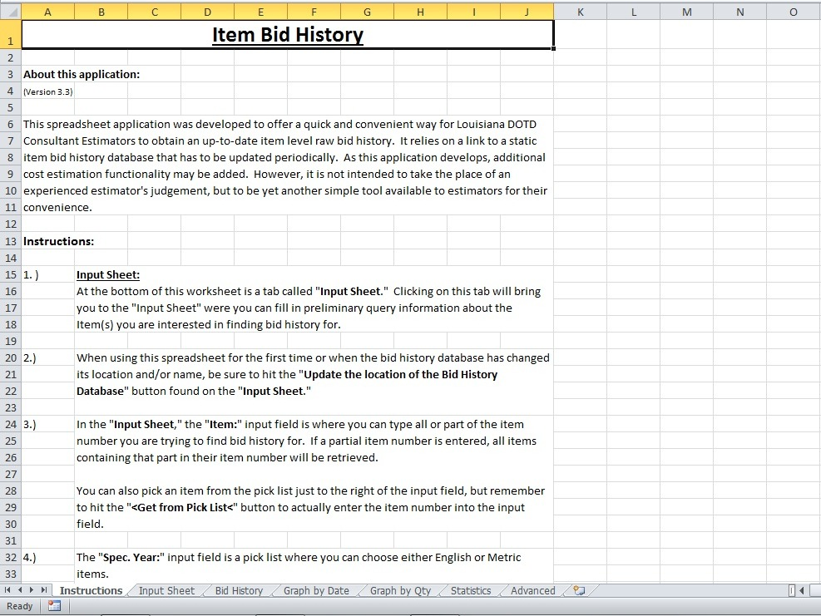

Slide 6
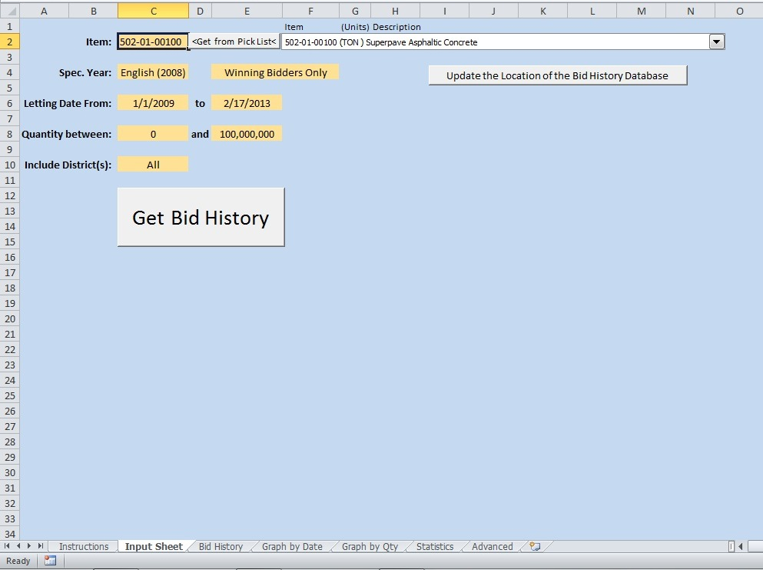

Slide 7
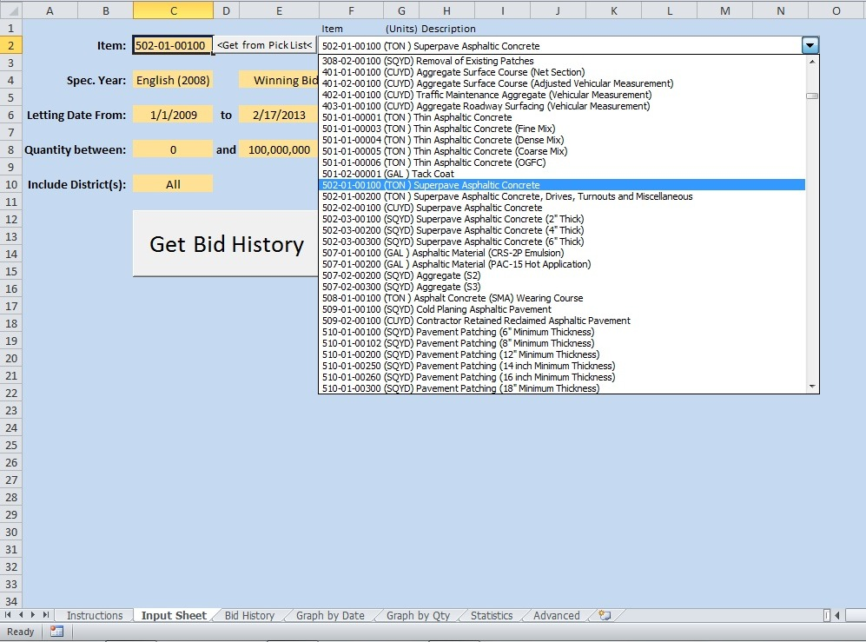

Slide 8
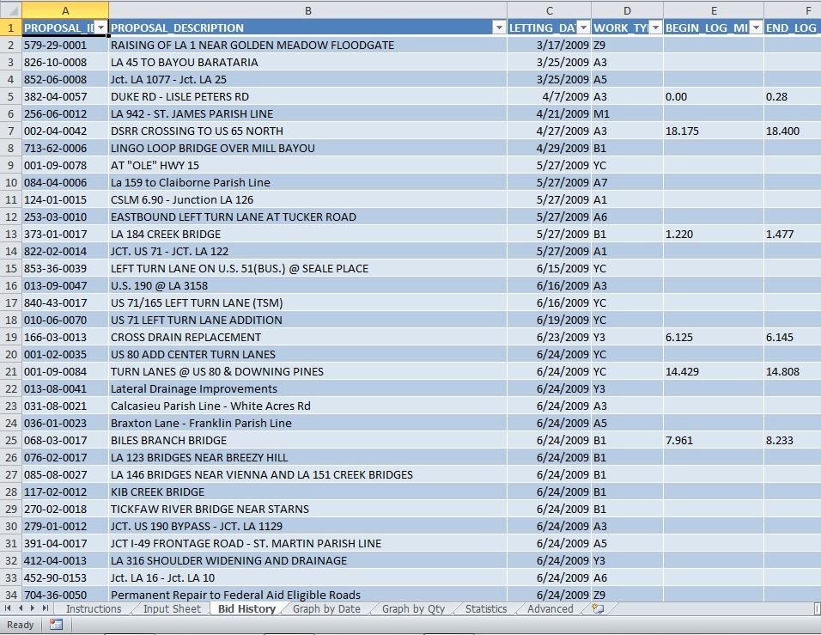

Slide 9
For additional filtering.

Slide 10
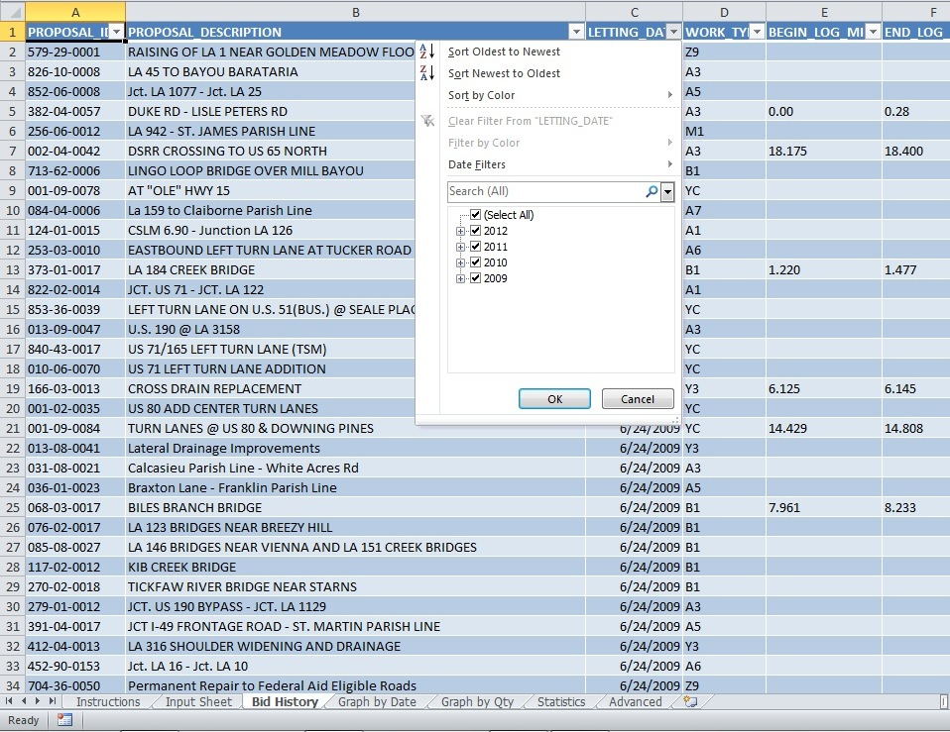

Slide 11
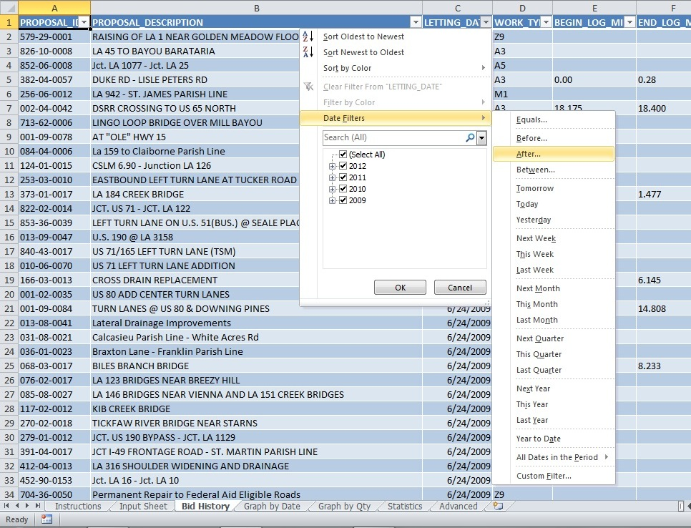

Slide 12
Example

Slide 13
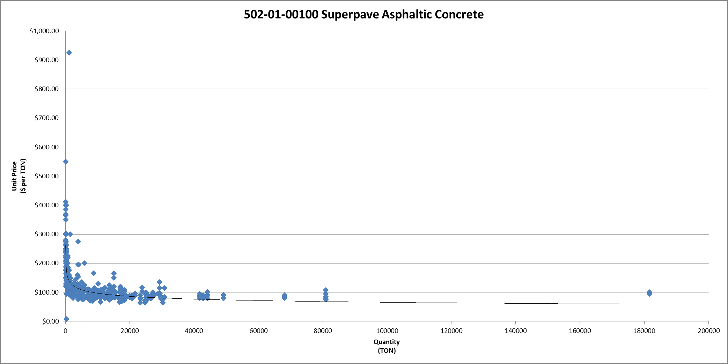
2015 Superpave Asphaltic Concrete Cost (Unit Price verses Quantity)
$900 Variance in Cost
Includes all bids (Unfiltered)
Notes:
La. DOTD tracks pay item bid costs over time.
Once pay items for a project are defined, bid history can be used to try and determine their costs.
One of the clear cost drivers of most pay items is quantity; however, there are other cost driving relationships that affect the price of a pay item.

Slide 14
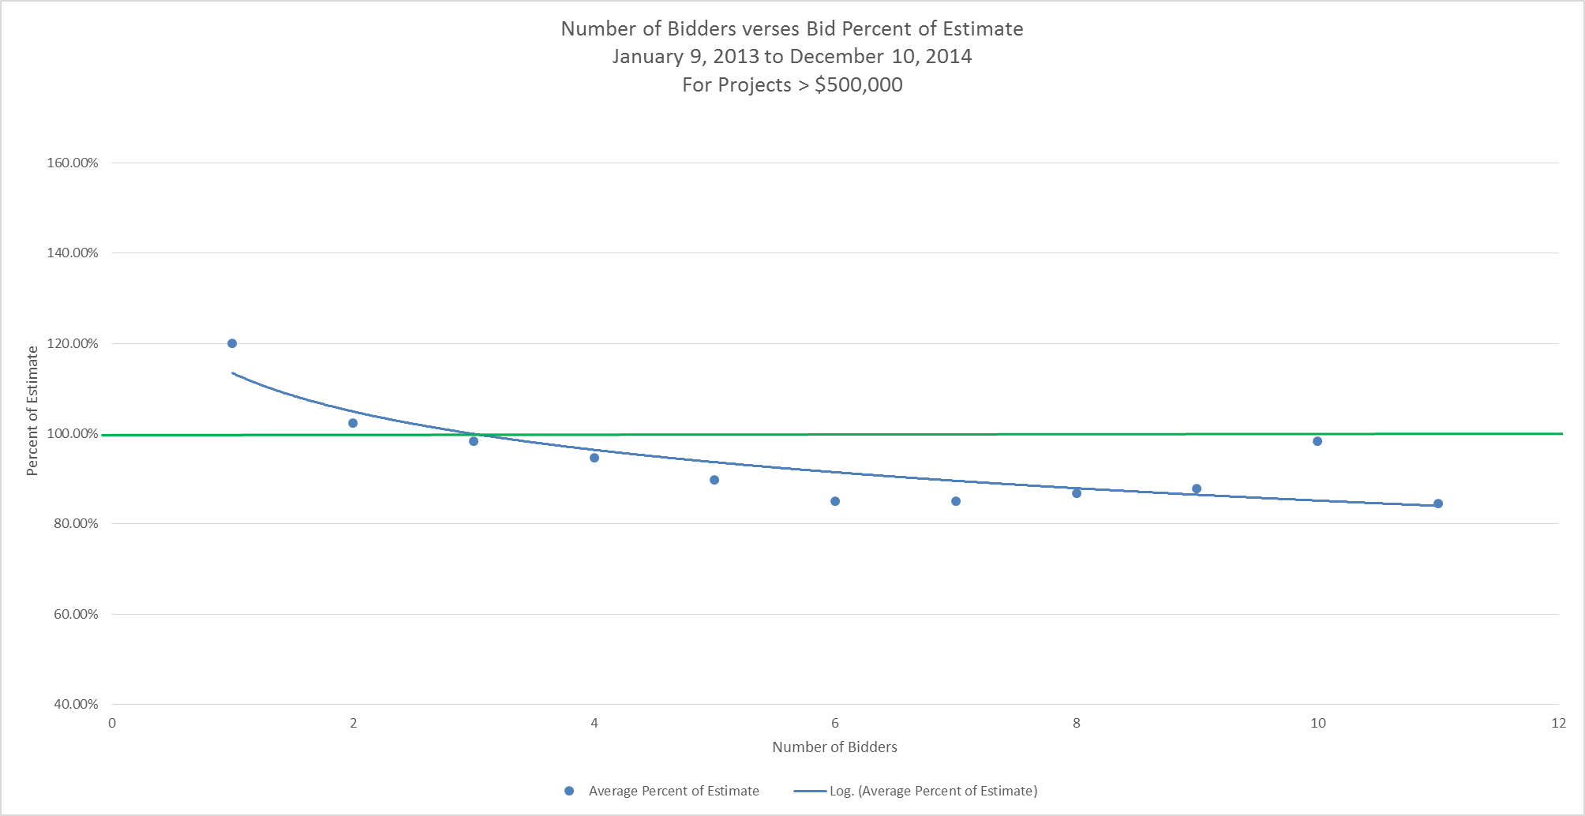
Effects of Competition on Bids
Notes:
The effects of competition on projects bid from 2013 through 2014 can also be seen in this graph.

Slide 15
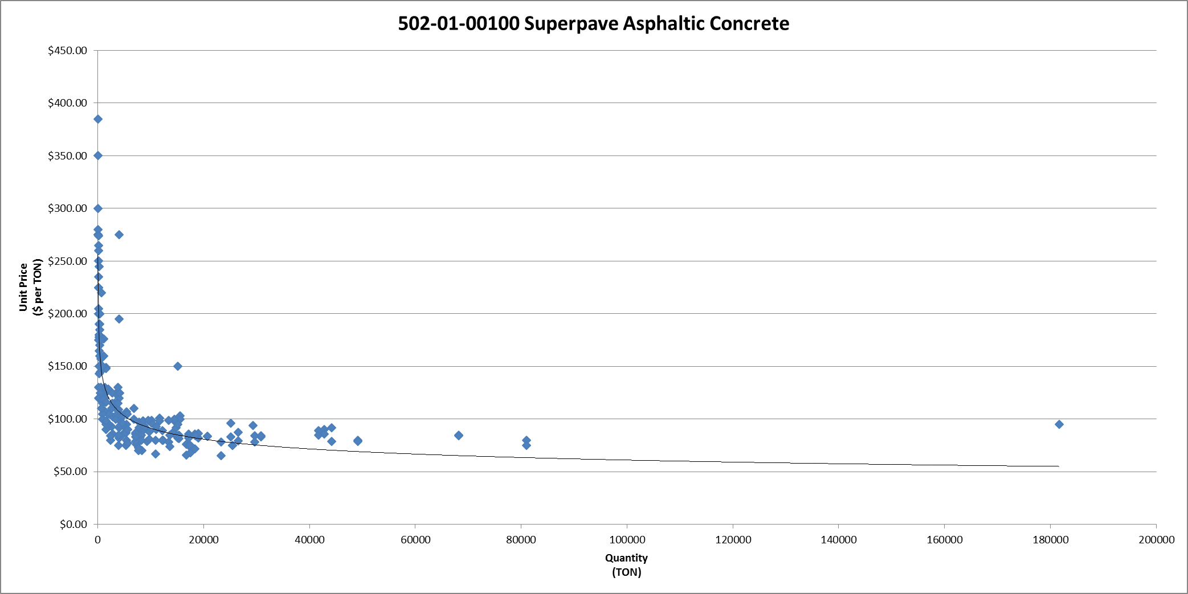
2015 Superpave Asphaltic Concrete Cost (Unit Price verses Quantity)
Projects with 3 or more bidders.
Only the low bidder and 2nd low bidder.
Less than $400 Variation
Notes:
The effects of competition on costs are considerable.

Slide 16
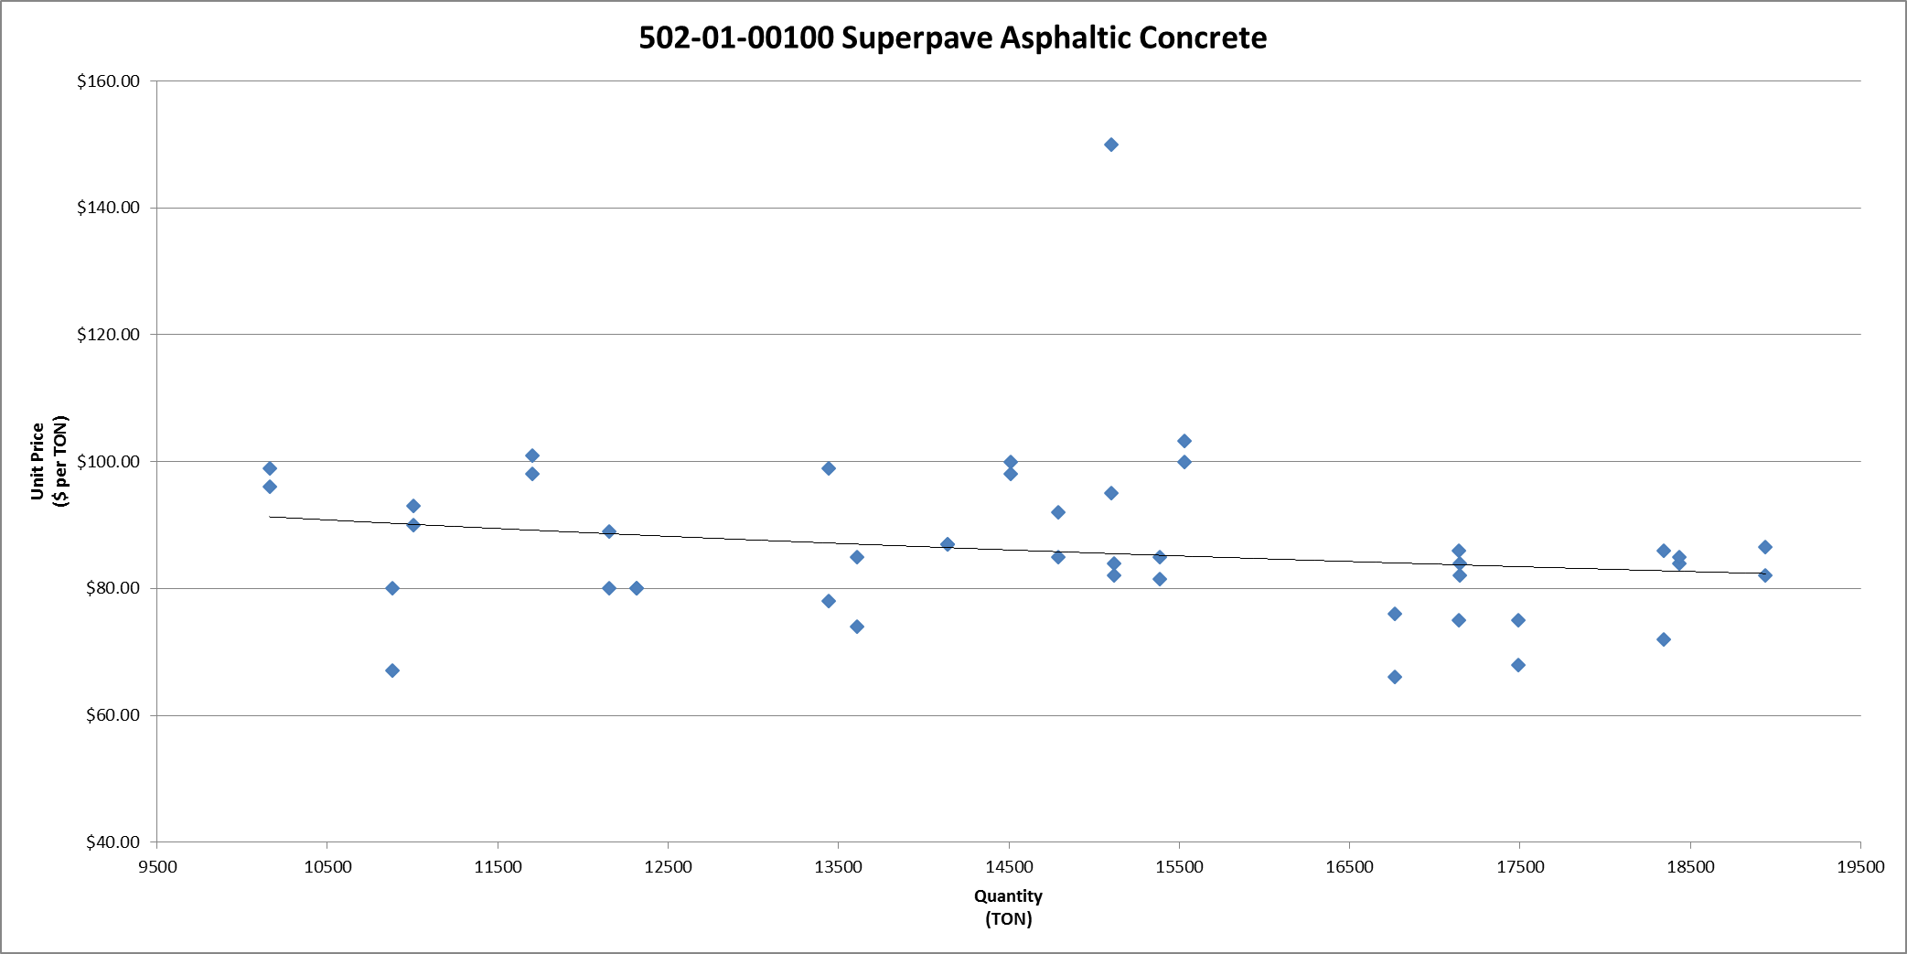
2015 Superpave Asphaltic Concrete Cost (Unit Price verses Quantity)
Projects with 3 or more bidders.
Only the low bidder and 2nd low bidder.
Quantities between 10,000 and 20,000 Tons.
Notes:
After narrowing the quantity range down, we notice the range in probable cost becomes much more narrower.
However, there is still some variation in costs.

Slide 17
2015 Superpave Asphaltic Concrete Cost (Unit Price verses Quantity)
Really?!
Projects with 3 or more bidders.
Only the low bidder and 2nd low bidder.
Quantities between 10,000 and 20,000 Tons.
About $35 Variation
Notes:
After narrowing the quantity range down, we notice the range in probable cost becomes much more narrower.
However, there is still some variation in costs.

Slide 18
2015 Superpave Asphaltic Concrete Cost (Unit Price verses Quantity)
What is the Unit Price for 15,000 Tons?
Projects with 3 or more bidders.
Only the low bidder and 2nd low bidder.
Quantities between 10,000 and 20,000 Tons.
About $35 Variation
Notes:
After narrowing the quantity range down, we notice the range in probable cost becomes much more narrower.
However, there is still some variation in costs.

Slide 19

The Number Will Deceive You
A single number for an estimate could insinuate false expectations.
Notes:
“The Number is Evil: An Exploration of Project Cost Estimating” by
Greg Brink, CVS, PMI-RMP, PMP, CCE/A
Value Management Strategies, Inc.

Slide 20
2015 Superpave Asphaltic Concrete Cost (Unit Price verses Quantity)
Maximum: $105
Most Likely: $85
Minimum: $70
Projects with 3 or more bidders.
Only the low bidder and 2nd low bidder.
Quantities between 10,000 and 20,000 Tons.
Notes:
Having said all of that about estimates being a range of numbers, we return back to the asphalt example.

Slide 21
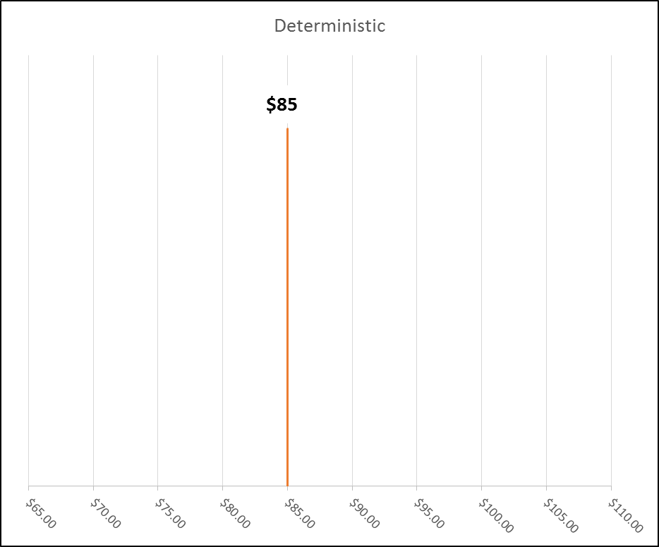
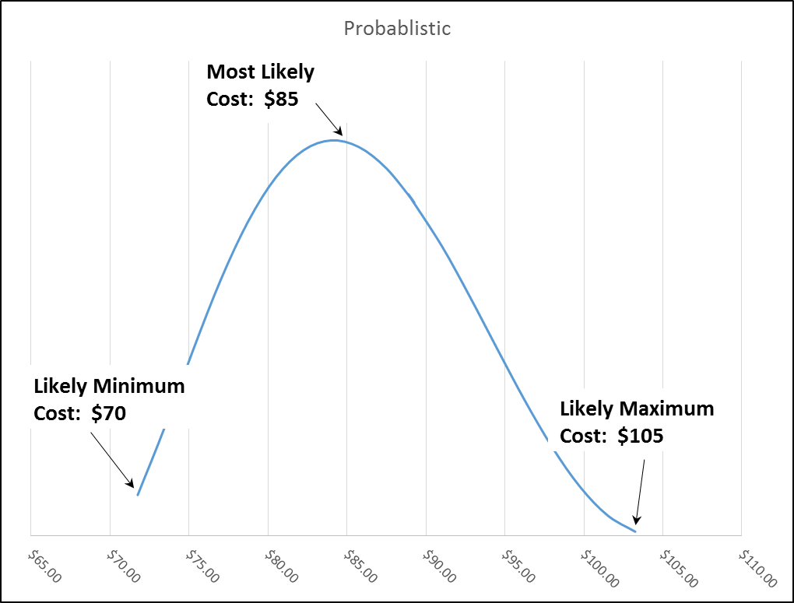
Deterministic verses Probabilistic
Assuming the estimated cost for a project is an average, then there is a 50% probability of exceeding the estimated cost.
Notes:
An estimate is more than just a number, it is a range of numbers, each with an associated probability of occurrence.
This allows a person to determine a cost based on a percentile associated with a certain level of confidence.

Slide 22
Focus Mostly on Major Items
Usually, only a handful of items will make up 80% or more of the total construction cost of a project.
Make sure to include Lump Sum items like Mobilization.

Slide 23
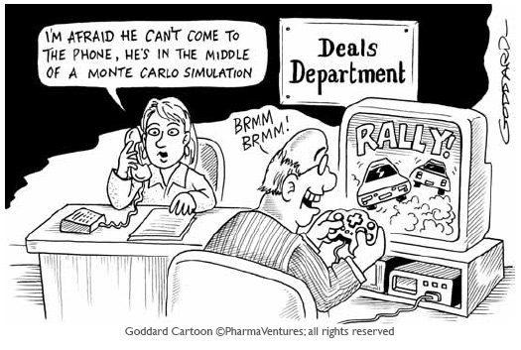
Monte Carlo Simulations?
Monte Carlo Simulation: A technique of multiple trial runs of random values that incorporate the underlying variability of individual elements to jointly determine a range of potential outcomes for a single output (i.e., project cost) by compiling all of the trial statistics.

Slide 24
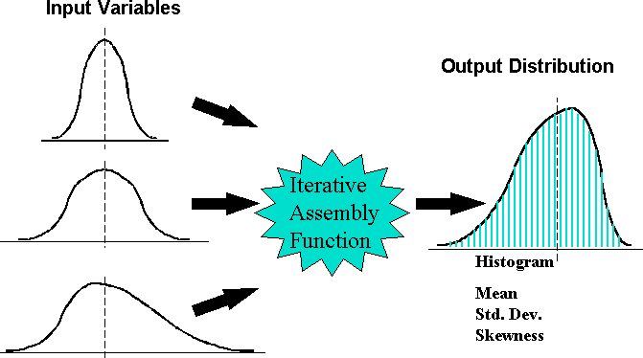
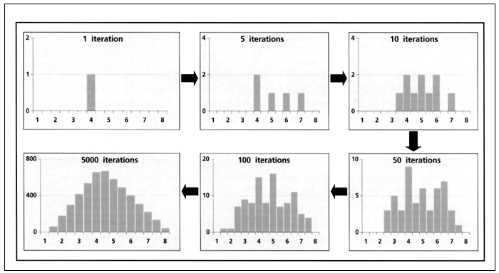

Monte Carlo Simulations?
Major Item 1
Major Item 2
Risk Element 1

Slide 25
Example

Slide 26
Monte Carlo Simulations
For this example project, out of 45 items only 9 major items accounted for over 80% of the cost of the project.
Notes:
Would be nice if I could demonstrate the application directly.

Slide 27
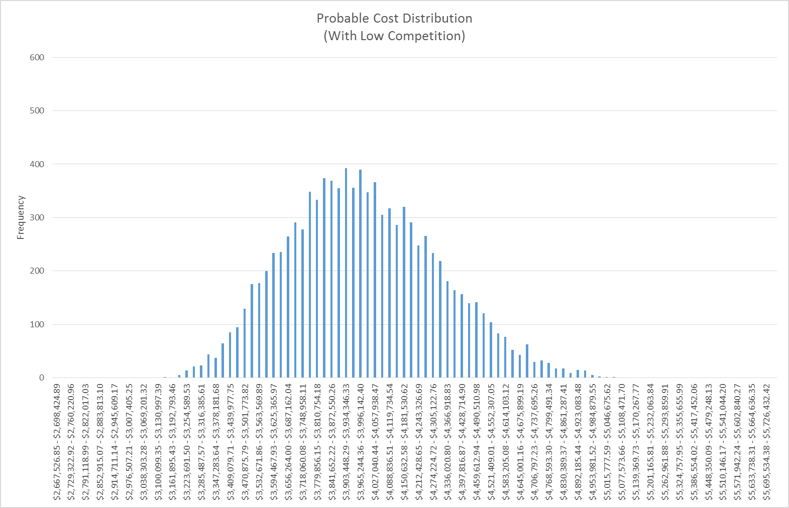
Monte Carlo Simulations
Assuming Low Competition as a Risk:

Slide 28
Monte Carlo Simulation Limitations
Modeling a Significant number of Major Items yields an inaccurately narrow probability cost distribution curve.

Slide 29
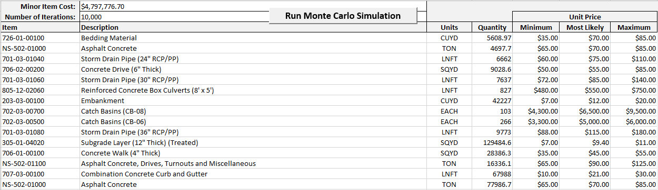
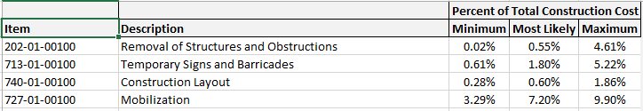
Monte Carlo Simulation Limitations
In this example, a total of 19 Major Items were modeled.

Slide 30
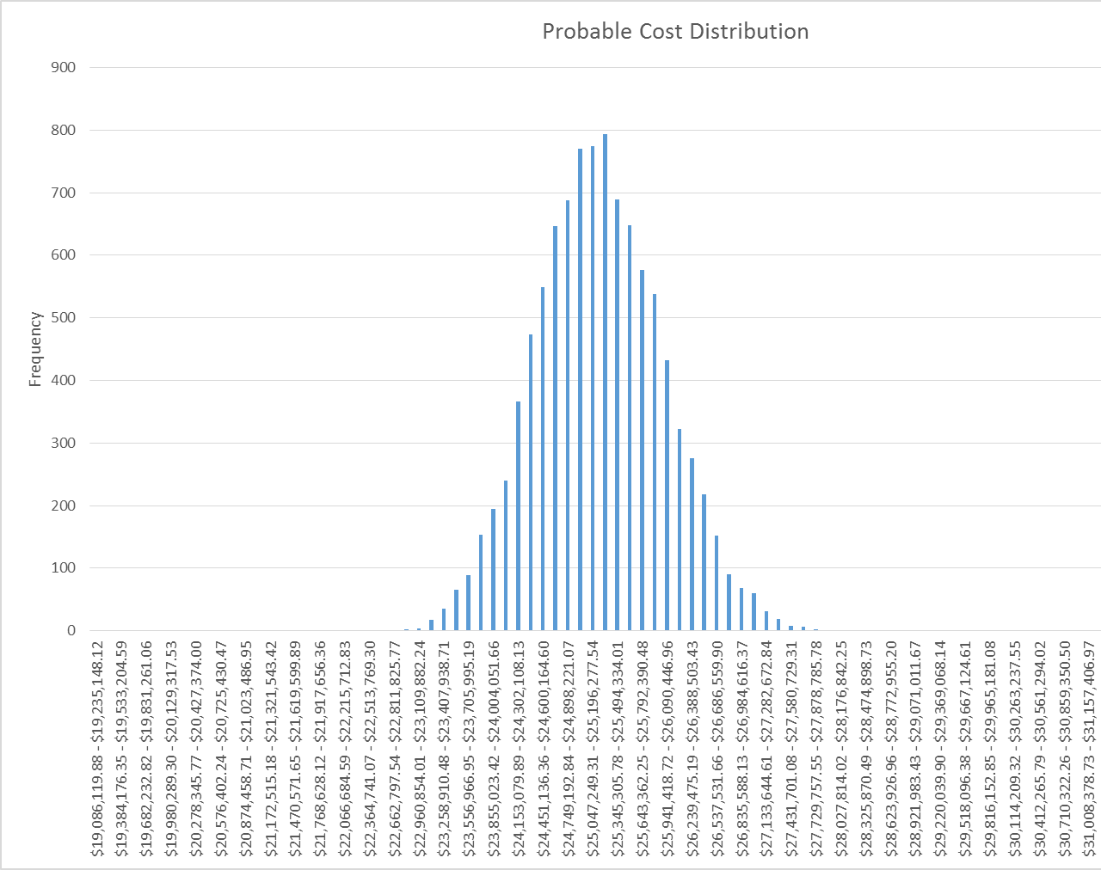
Monte Carlo Simulation Limitations
This yielded a narrow range of probable cost with a 70th percentile probable total cost of $25,598,940.36.

Slide 31
Monte Carlo Simulation Limitations
Items of similar work type are likely to be bid similarly.
For example, if a contractor bids high on one asphalt item, they are likely to bid high on other asphalt items as well.
Based on this assumption, similar items were grouped together and each group of items was modeled as an individual item.

Slide 32
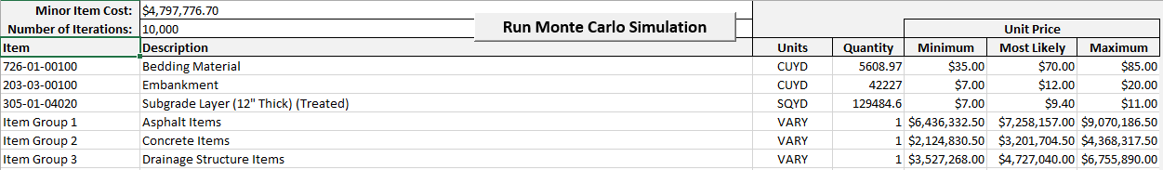
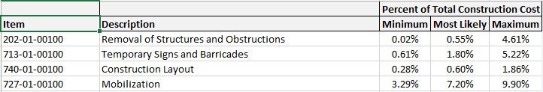
Monte Carlo Simulation Limitations
This yielded only10 Major items that needed to be modeled, with a 70th percentile probable cost of $25,780,715.78 which is less than 1% more than the previous model’s $25,598,940.36.

Slide 33
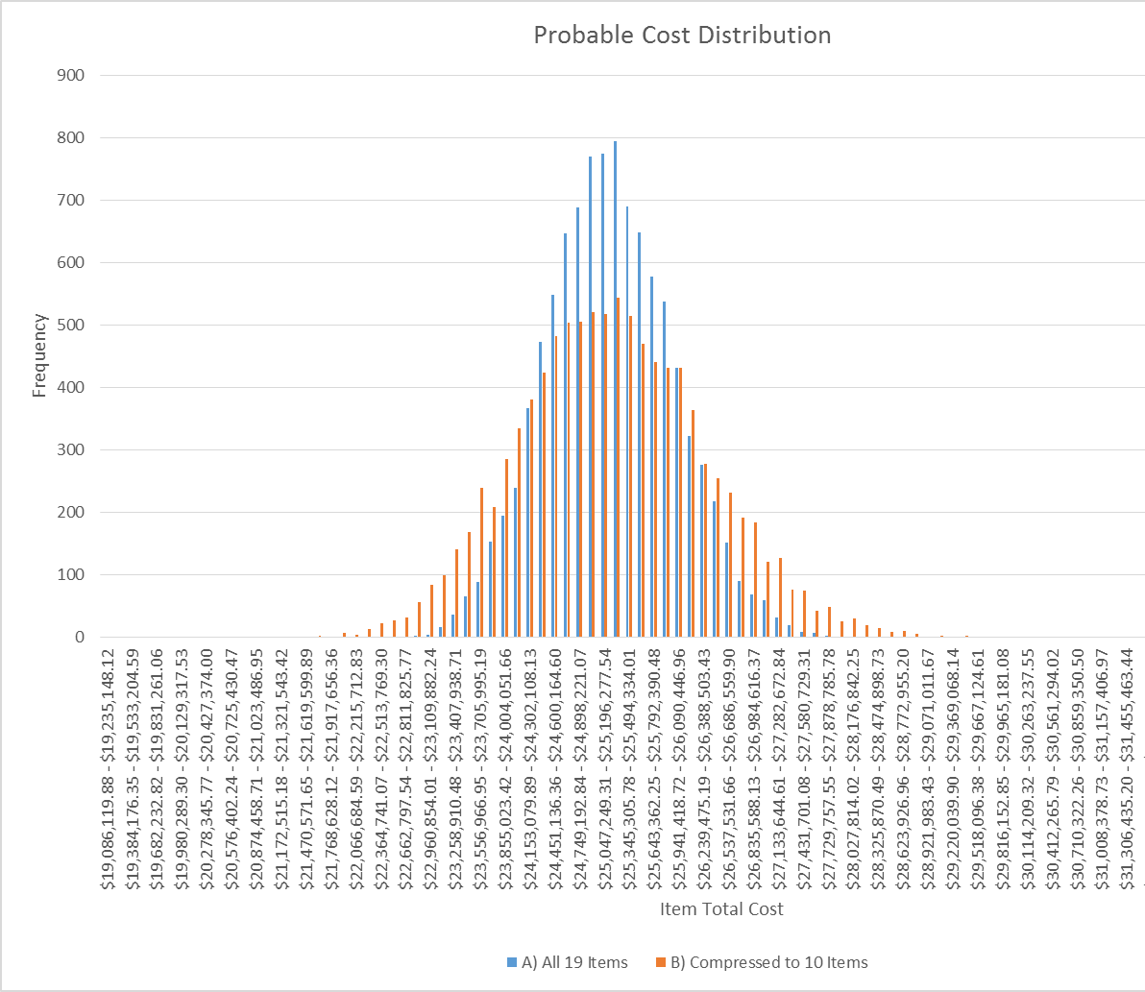
Monte Carlo Simulation Limitations
The biggest difference is revealed in the probable range in cost.

Slide 34
Monte Carlo Simulation Limitations
The moral of the story is to try to keep the number of major items to be modeled to a minimum by grouping similar items together and model each group of similar items as an individual item.
More sophisticated techniques do exist to better address this issue, but currently, this method is easier and more practical, given the resources available to us.

Slide 35
Questions/Comments?
Jonathon Courtney
DOTD Economist
Jonathon.Courtney@LA.gov
(225) 379-1078

