Slide 1
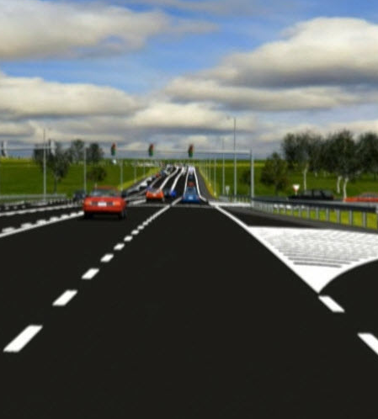
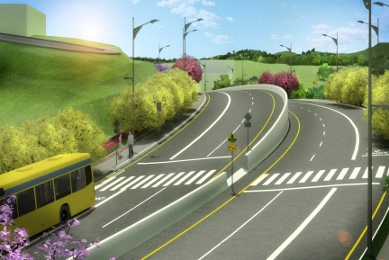
Automating LaDOTD Design Publishing ( Updated 2/27/2013 - HW )
Hollis Ward: DOTD Design Automation Manager: hollis.ward@la.gov
Tom Atkinson: Bentley Information Management Sales Executive

Slide 2
Automated PDF Publishing Project Goals
Automate PDF Plans Publishing
Automate Digital Signature Workflow
Empower Design Consultants to Publish/Sign Plans
Automate PDF Transfer to Bidder Plans Room

Slide 3
Project Tasks
PDF Creation Service:
  Provide the functionality within ProjectWise for users to select MicroStation Design Files and click a command that will generate PDF copies of the drawings.
  Use the name and attributes of each document to establish the name and attributes of each PDF and to create the folder in which to place the PDF documents.
  Determine the ProjectWise InterPlot Settings to use.
  Provide connectivity for client systems, outside the LADOTD network, to submit PDF plan requests the same way as LADOTD staff.

Slide 4
Project Goals
Export/Import Signed Documents:
  Provide the functionality to control and manage the Export and Import process of PDF documents in and out of ProjectWise for digital signature using standard digital signature software adopted by LADOTD.
Export to Plans Room:
  Provide the functionality to export PDF documents and companion XML files containing the ProjectWise attributes to a predetermined Windows folder. This “watched folder” is monitored by the bidder “Plans Room” system, which will import the files and populate the attribute values for each document.

Slide 5
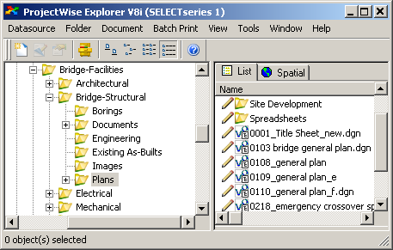
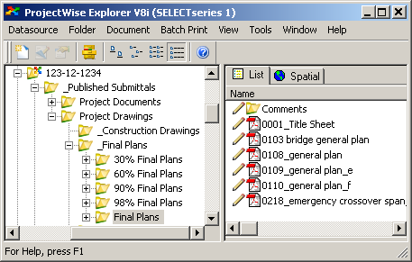
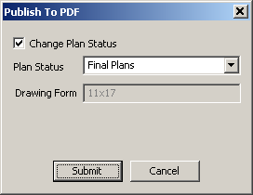
Publishing with “Publish to PDF”
Input CAD DGNs
Output PDFs
Select DGNs to Publish
Select “Publish to PDF”
Select Plan Status
Click “Submit”

Slide 6
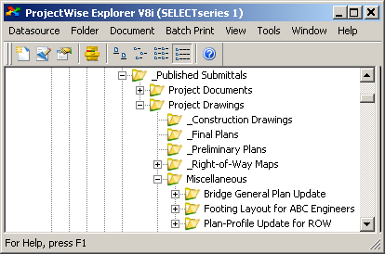
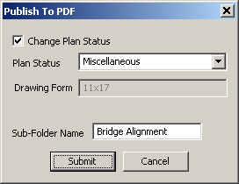
Ad-Hoc Drawing Submittals
Publish To PDF” can create ad-hoc submittals
  (“Miscellaneous” Submittals)
Used for important updates between benchmarks

Slide 7
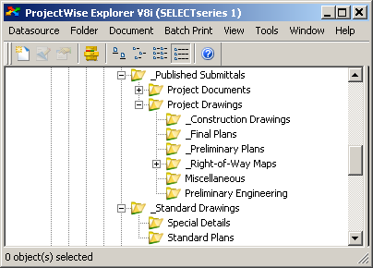
Published Submittals Template
Submittal category root folders start empty (e.g., ‘_Final Plans’)
‘Publish to PDF’ creates each plan submittal subfolder when needed (e.g., ’95% Final Plans’).

Slide 8
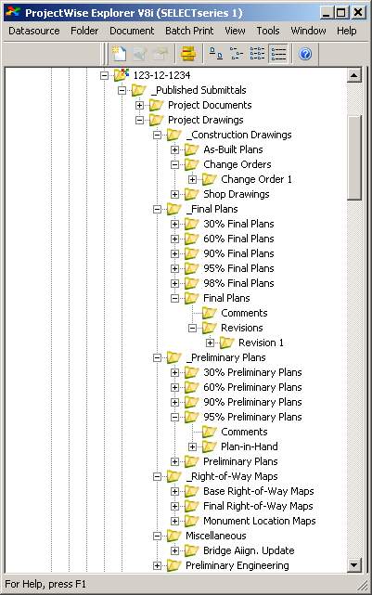
Submittals at Project Completion
Example Project with
Completed Submittals
Submittal folders (e.g., ’95% Final Plans’) are created when PDFs are published
Plus signs on folders indicate that one or more PDF files exist. Press Function key F5 to see latest status

Slide 9
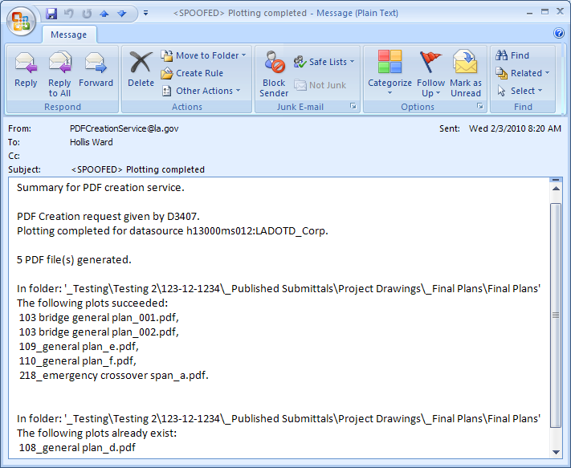
PDF Creation Service Email
Information about PDF Creation Success/Failure

Slide 10
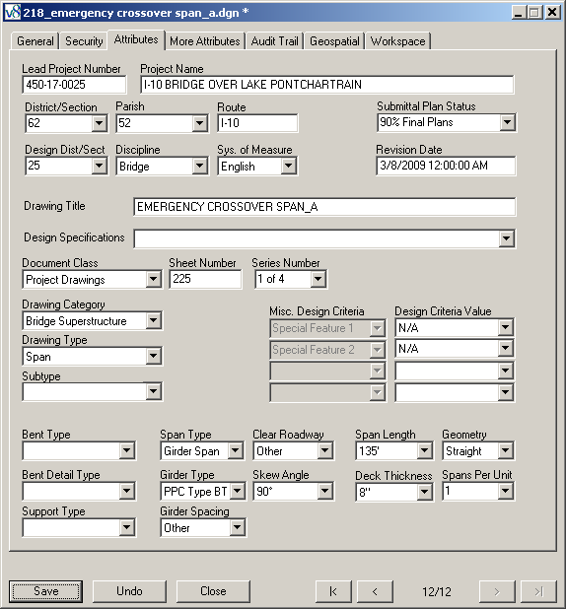
Project Wise Attributes Page
“Publish To PDF” passes attribute values from DGN to PDF (Used for Document Searches in ProjectWise and Plans Room)

Slide 11







Plot Information Transfer
DOTD Network
DMZ Firewall
ProjectWise Integration Server
ProjectWise Plot Server
Custom Publishing Solution
ProjectWise Gateway Server
FTP Server
External User
<Animated>
Turned off by default. It may be helpful to turn it on for this this type of slide
DOTD User

Slide 12



Digital Signature Workflow and Audit
ProjectWise Integration Server
DOTD User
<Animated>
PDFs are Exported from ProjectWise to Windows
  Logs Date, Time, User, Folder, “Exported for Digital Signature”, etc.
Silanis Digital Signature Process is Executed
PDFs are Imported Back to ProjectWise
  Verifies documents are signed (otherwise, will not import), and then imports
  Deletes signed PDF files in Windows folder
  Logs Date, Time, User, “Imported Digitally Signed Document”, etc.
  Updates “Signature Status” attribute value to “Signed”
  Updates PDF document status to “Final Status” (Locked)

Slide 13
Bentley Custom PDF Signature Workflow from the Driver’s Seat
    Export PDF/ Import Signed Document
      Highlight PDF drawings to sign in ProjectWise
      Right-Click and select “Export for Signature”
        Exports drawings to C:\PW_SignatureDir
      Sign drawings using Silanis ApproveIt
      Right-click and select “Import Signed Document”
        Checks to make sure drawings are signed.
        Imports drawings and sets “Final Status”
        Sets “Signature Status” attribute to “Signed”
        Records audit trail of signing ceremony

Slide 14

Export to Plans Room
ProjectWise Integration Server
Electronic Plans Room Server
<Animated>
DOTD User
DOTD User selects “Export to Plans Room” Command
Document Attributes are written to an XML file
The PDF and XML files are copied from ProjectWise to a predetermined Folder
The Electronic Plans Room runs a service that watches this folder
The PDF and XML are imported as a new, “indexed” document

Slide 15
Bentley ProjectWise Custom PDF Publishing Extension
    “Publish To PDF” Makes Publishing Easy
    Creates PDFs without user plotting setup
    Creates output folder for PDFs (e.g., Final Plans)
    Copies attribute values from DGN to PDF
    Sends email documenting PDF creation status
    Manages PDF Digital Signing Ceremony
    Exports PDF and XML index to Falcon “Plans Room”
    Publishes Deliverables for DOTD and Consultant partners

Slide 16
Consultant Plan Delivery Before New Process
Publishing Plan On Hold Before Automated PDF Publishing
  Consultants must create PDF plans on their site using InterPlot
  Consultants must index plans using ControlCAD ‘Indexer’ on their site
  Plan delivery required Consultants to package all DGNs, PDFs & XML Index Files
  DOTD must process Consultant packages
  CAD design plan QA/QC practical for ‘Final Plans’ only
  This system was considered a great improvement at the time, but staffing to process the submittals was not provided.
  DOTD focus on meeting ‘Plan Delivery Dates’ was more important than enforcing workflow and data standards. Conforming to standards was essentially on the honor system.
  Compliance depended on Project Manager, Task Manager and Consultant priorities. PDF publishing was therefore ad-hoc and not for formal submittals.

Slide 17
Project Impact on DOTD Plan Delivery
  PDF plans published using automated Bentley PDF Creation Service
  PDF plan production using this “EZ Publish” system is far faster and more efficient than paper for all submittal milestones.
  PDF Creation Service requires CAD DGNs to reside in ProjectWise
  Consultants must upload CAD designs and participate in DOTD ProjectWise plan delivery process.
  CAD DGNs in ProjectWise enable ControlCAD Reports in ProjectWise
  ControlCAD Reports provide feedback at each submittal milestone
  Ultimate Result: Both publishing and QA/QC is very efficient

Slide 18
Typical Transmittal Email
Transmitted herewith is a link to the Final Plans for the referenced project in ProjectWise. These Plans are submitted for the your review and approval via Title Sheet signature.
S.P. No. H.009101
Interchange Lighting
I-55 @ LA 16 (Amite)
Route I-55
Tangipahoa Parish
Link to Final plans: Final Plans
Transmittal verbiage varies depending on plan delivery milestone and related directives.

Slide 19
LaDOTDAutomated Plan Delivery Another Way to Look at it

Slide 20
DOTD Internal Plan Delivery Workflow
CAD Plans Folder
Draft, Conform & Certify with CADconform. Index in ProjectWise.
CAD Plans Folder
Animated
ProjectWise Plan
Development
System
CAD Plans Folder
Falcon Electronic Plans Distribution Center
PDF Drawing
XML Index
“Watched Folder”
PDF Submittal Folder
Sign Final Plan Drawings with ApproveIt
PDF Drawing
PW Index
PDF - Adobe file format used for published documents
XML - File format used to store attribute values (indexing)
ProjectWise - Bentley Plan Development System
Falcon - tsaADVET Electronic Plans Distribution System
Watched Folder - Monitored by Falcon for incoming plans
PDF Submittal Folder
(“Final Plans”)

Slide 21
Consultant Plan Delivery to DOTD System (Abandoned Design)
ProjectWise Plan
Development
System
CAD Plans Folder
Animated
Falcon
Electronic Plans Distribution Center
PDF Drawing
XML Index
“Watched Folder”
PDF Drawing
XML Index
Watched Folder
PDF Submittal Folder
Too much happening outside of ProjectWise. Compliance remained a mystery until Finals
PDF - Adobe file format used for published documents
XML - File format used to store attribute values (indexing)
ProjectWise - Bentley Plan Development System
Falcon - tsaADVET Electronic Plans Distribution System
Watched Folder - Monitored by Falcon for incoming plans
DGN Drawing
PDF Drawing
XML Index
ControlCAD
Submittal Archive
Create PDF Drawing with Interplot
Sign Final Plans with ApproveIt
Consultant Plans Repository
Index PDF & DGN (ControlCAD Indexer)
Draft, Conform & Certify Final CAD DGN with CADconform

Slide 22
Consultant Plan Delivery Workflow
(Adopted Design)
ProjectWise Plan
Development
System
Animated
CAD Plans Folder
Falcon
Electronic Plans Distribution Center
PDF Drawing
XML Index
“Watched Folder”
PDF Drawing
XML Index
Watched Folder
PDF Submittal Folder
Consultants employ DOTD internal workflow to index, publish and sign.
Altiva ControlCAD Reports replace ControlCAD Submittal tool
PDF - Adobe file format used for published documents
XML - File format used to store attribute values (indexing)
ProjectWise - Bentley Plan Development System
Falcon - tsaADVET Electronic Plans Distribution System
Watched Folder - Monitored by Falcon for incoming plans
Export / Import All DGNs
(Managed)
External plan delivery tools, ControlCAD Indexer and ControlCAD Submittal, are no longer used
Consultant Plans Repository
Draft, Conform & Certify DGN with CADconform

Slide 23
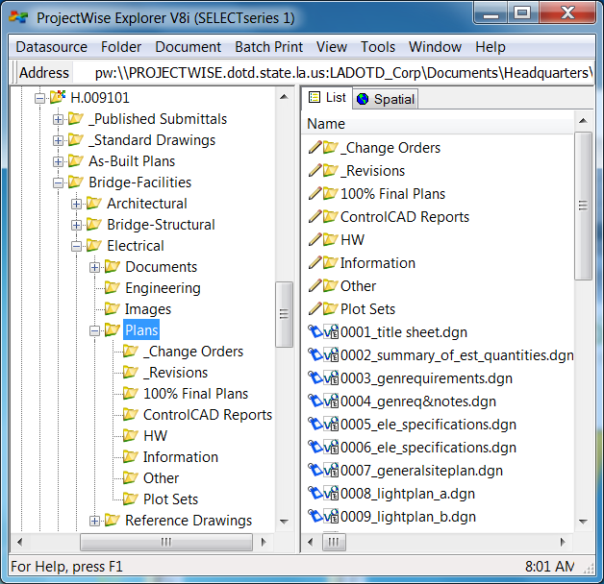
Drawing Management for PDF Publishing
Create DGN plans in, or drop plans into, the Plans Folder (Consultants always drop* )
Scan or Attach Ref. Files
Move Reference Files into \Reference Drawings
Publish Plan submittals to PDF format
Repeat Process as needed at Plan Delivery Milestones
* Drop plans into folder first submittal. Then “drop” or managed Export/Import.
DOTD Software Support: IT “Service Request”
Consultant Support
hollis.ward@la.gov or Task Manager

Slide 24
Digital Signature Technology
(Finding the Right Solution)

Slide 25
DOTD Digital Signature Solution
    Digital Signature Implementation Hurdles
    State Law
    State Office of Information Technology
    Technology Selection
    LAPELS Review > Approval
    User Resistance > Buy-in
    Integration with ProjectWise

Slide 26
Louisiana Professional Engineering and Land Surveying Board (LAPELS) - Digital Signature Rules -
    Chapter 1, 105 Definitions; page 3:
    Signature – handwritten or digital as follows:
    b. a digital signature which is an electronic authentication process attached to or logically associated with an electronic document. The digital signature must be:
      unique to the person using it
      capable of verification
      under the sole control of the person using it
      linked to a document in such a manner that the digital signature is invalidated if any data in the document is changed .

Slide 27

CAD Seal and Digital Signature
CAD Seal
Electronic Rendition of Digital Signature
Dawn Smith’s Seal and Digital Signature

Slide 28
ApproveIt Certificate Information
Individual X.509 v3 identification certificate information from the embedded audit trail of the signed PDF (Industry Standard)
Each identification certificate generated by the ePersona creation process is unique.
Choice of Certificate Authorities: VeriSign ($); ApproveIt CA (no cost!) Internal trusted person’s ePersona (no cost!)…
Details of Dawn’s Certificate

Slide 29
Signature Authentication Info
Name of user profile signed on to system

Slide 30
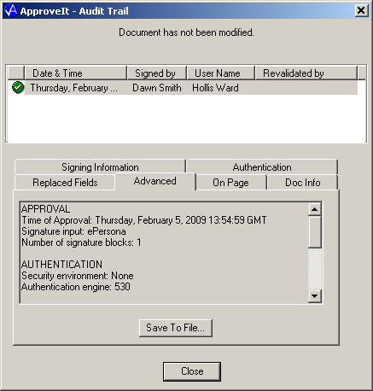
Signature Date/Time
Date / Time

Slide 31


DOTD Digital Publishing Technology
Forward Looking !

