Slide 1
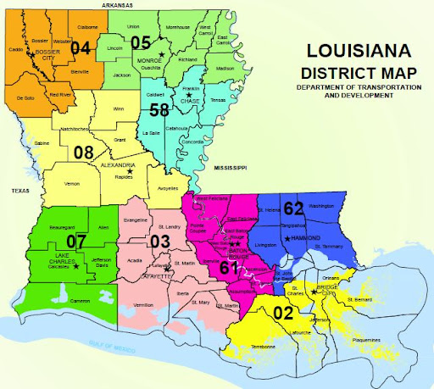
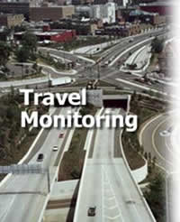
Traffic Monitoring and Data Collection
Section 21

Slide 2
What is Traffic Monitoring?
The Louisiana Department of Transportation & Development (LA DOTD) conducts traffic monitoring and data collection surveys to determine the volumes and types of vehicles and weight of trucks using the Louisiana highway system.
The annual traffic monitoring program, and its data, provides information essential to the general administration of the highway programs(HPMS) and to the current and historic traffic data for the public road system.
Traffic data are fundamental to determining vehicle miles of travel, project design parameters, highway classification, and the level of service, provided by a highway facility.
The program includes the collection, processing, summarization, data storage and reporting of traffic count data along Louisiana roadways and highways.

Slide 3
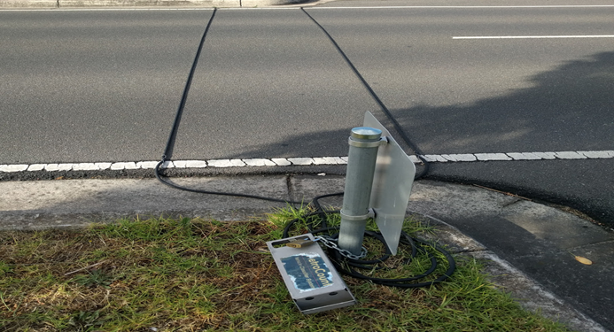
The LA DOTD traffic monitoring program can be divided into the following branches:
Continuous Count Program- (Volume)
Routine Count Program- (Volume)
Blanket Count Program(Local Roads)- (Volume)
Classification Count Program- (Vehicle classification type)
Truck Weigh-in-motion (WIM) Program- (Tire impacts to road pavement)
Long Term Pavement Performance Program
Special Needs

Slide 4
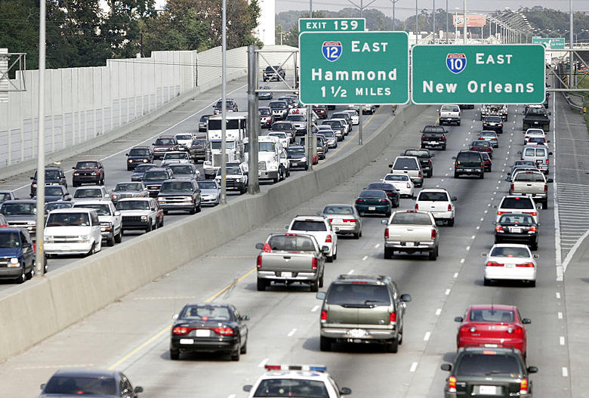
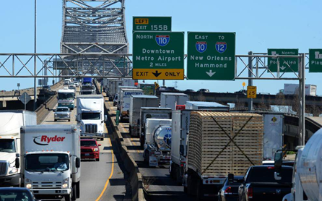
The following is a list of the road systems included in the traffic data collection program:
State Routes
Interstates
U.S. Routes
Parish (County) Roads
City Streets
Ramps
Long Range Plan (LRP )

Slide 5
The LA DOTD traffic counting program is designed to utilize, at a minimum, 48-hour short-term counts to produce estimates of Annual Average Daily Traffic (AADT).
The 48-hour Short-Term Count Program includes about 5,246 volume sites, 1,406 class sites, and 63 WIM sites all counted in a three-year cycle. The Ramp count program includes about 489 ramps counted in a six-year cycle.
In addition, a few “special” counts are performed sporadically each year as needed. These special counts also include volume, classification, or even WIM as well.
At present, the LA DOTD maintains and operates permanent or continuous traffic recorders at approximately 55 sites.

Slide 6
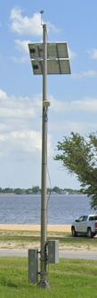
Continuous Count Program
The Continuous traffic Count Program is designed to collect vehicular traffic data in one-hour increments 24 hours a day throughout the year.
LA DOTD operates and maintains approximately 55 permanent stations where traffic is monitored continuously by a combination of radar-type or loop-type traffic counters 365 days per year.
Data from the 55 automatic traffic recorders is poled daily by the use of a modem and the data is automatically downloaded into the LA DOTD Traffic Server which is being hosted by MS2 .

Slide 7
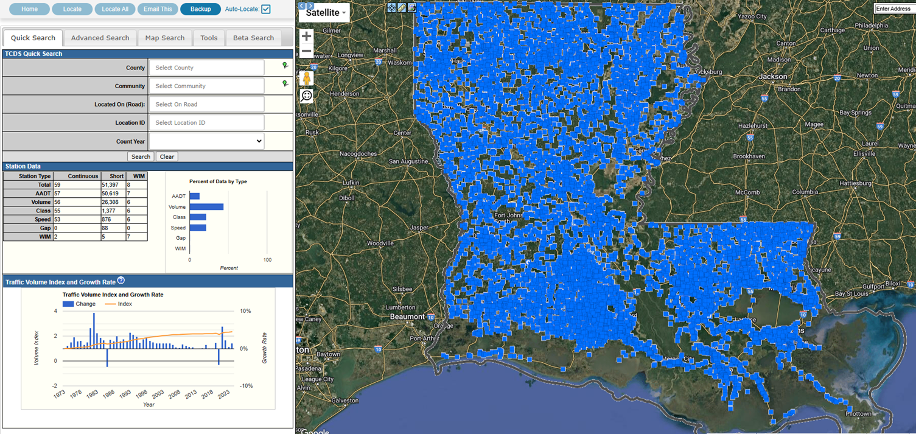
Modern Traffic Analytics (MS2)
MS2 Traffic Count Database System (TCDS) is a powerful cloud-based software solution that allows transportation planners and traffic engineers to map, manage and analyze vehicle traffic count data
TCDS maps WIM, short count, and permanent count stations on an interactive map. Count datasets accepted through this solution include Traffic Volume, Speed, Vehicle Classification (axle and length-based), Per Vehicle Record, WIM, and gap.

